Slide 1
Pipelines. The plumber’s view.
Building systems with complex data-science component.
Notes:
Hi! I kind predicted beforehand that I will be second presenter, so I hope you forgive me some slight taste of funny story in this presentation.
Today I would like to present you the topic I have been working since the beginning of this year. I gathered information from multiple sources and build a prototype of a platform to discover, try and prove that principles and solutions are working.
Why I think it can be important not olny for developers, but also to data scientists and UX-designers?
During aprox 1.6 year while have been developing Smart I noticed some divelopment and integration patterns as well as antipatterns, following / avoiding which can bring huge effect. Here I am talking about productivity, feature outcome, personnal satisfuctions and more.
All this patterns and principles appear on the eges of integration between UX, FE, BE and DS.
Let’s go to agenda.

Slide 2
Agenda
Fairy-tale
King-client
Models & serving
Compute
Function security
Kafka
BONUS! Models deployment
Notes:
I plan to start from a kind of art work. I think a few peope knows already that I help my children make small Playmobil video stories.
I decided to build presentation in type of quest, but lets talk about it in “Fairy-tale” part.
Next I would like to introduce a special guy. From his angle I would like to build all next argumentation.
So we will define main challenges this guy have to deal with, as well as, provide ideas to metigate them on the next pages.
And of course bonus.
Usually in books after a table of contents goes acknowledgement session.
In my case I would like to give my acknowledgements to early reviewrs of my work: Ali, Ben, Christian Becker, Federica. Yours help, advices and feedback help me a lot.
This winter I passed Coursera 4 month training on data science model deploymen. It was payed by BIX, so I would like to give special thanks for BIX leadershit team.
And of cource special thanks for former Smart team and other people of BIX I could share my ideas and get help and support.

Slide 3
Fairy-tales, though far from true, Teach good lads a thing or two. Pushkin(trans. by B. Deutsch)
Notes:
This preface I’ve selected by purpose, I want to make this presentation as light as possible, disregarding sometimes havy topics it includes. I basically it is derection for me to follow.
So, lets start our travel.

Slide 4
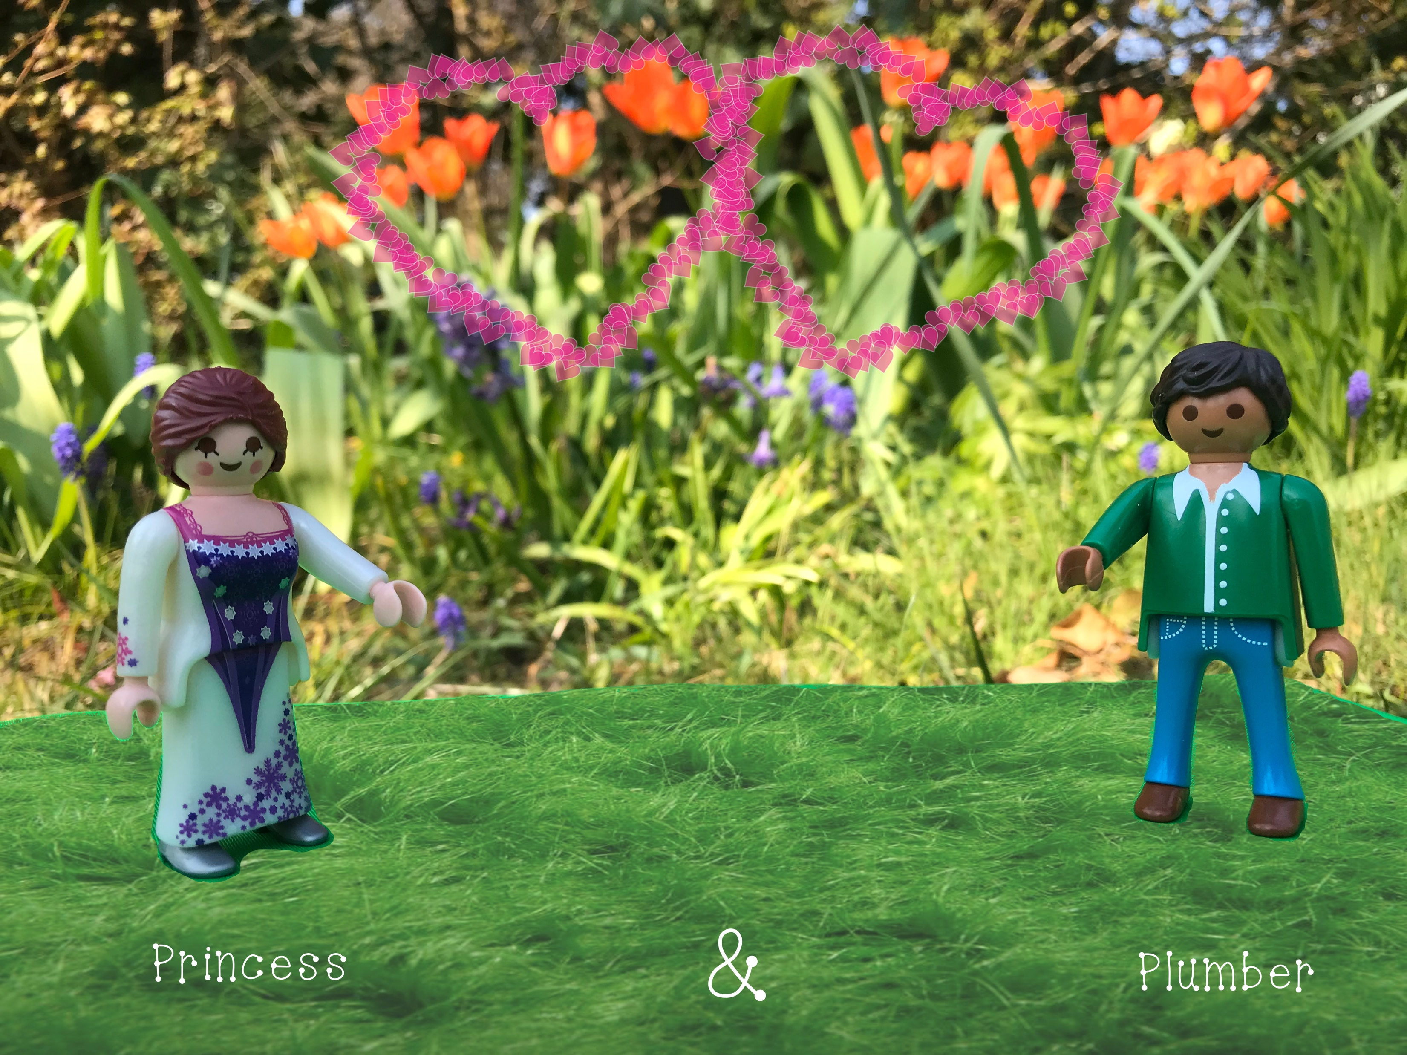
Notes:
Fairy-tale section coming! ☺

Slide 5
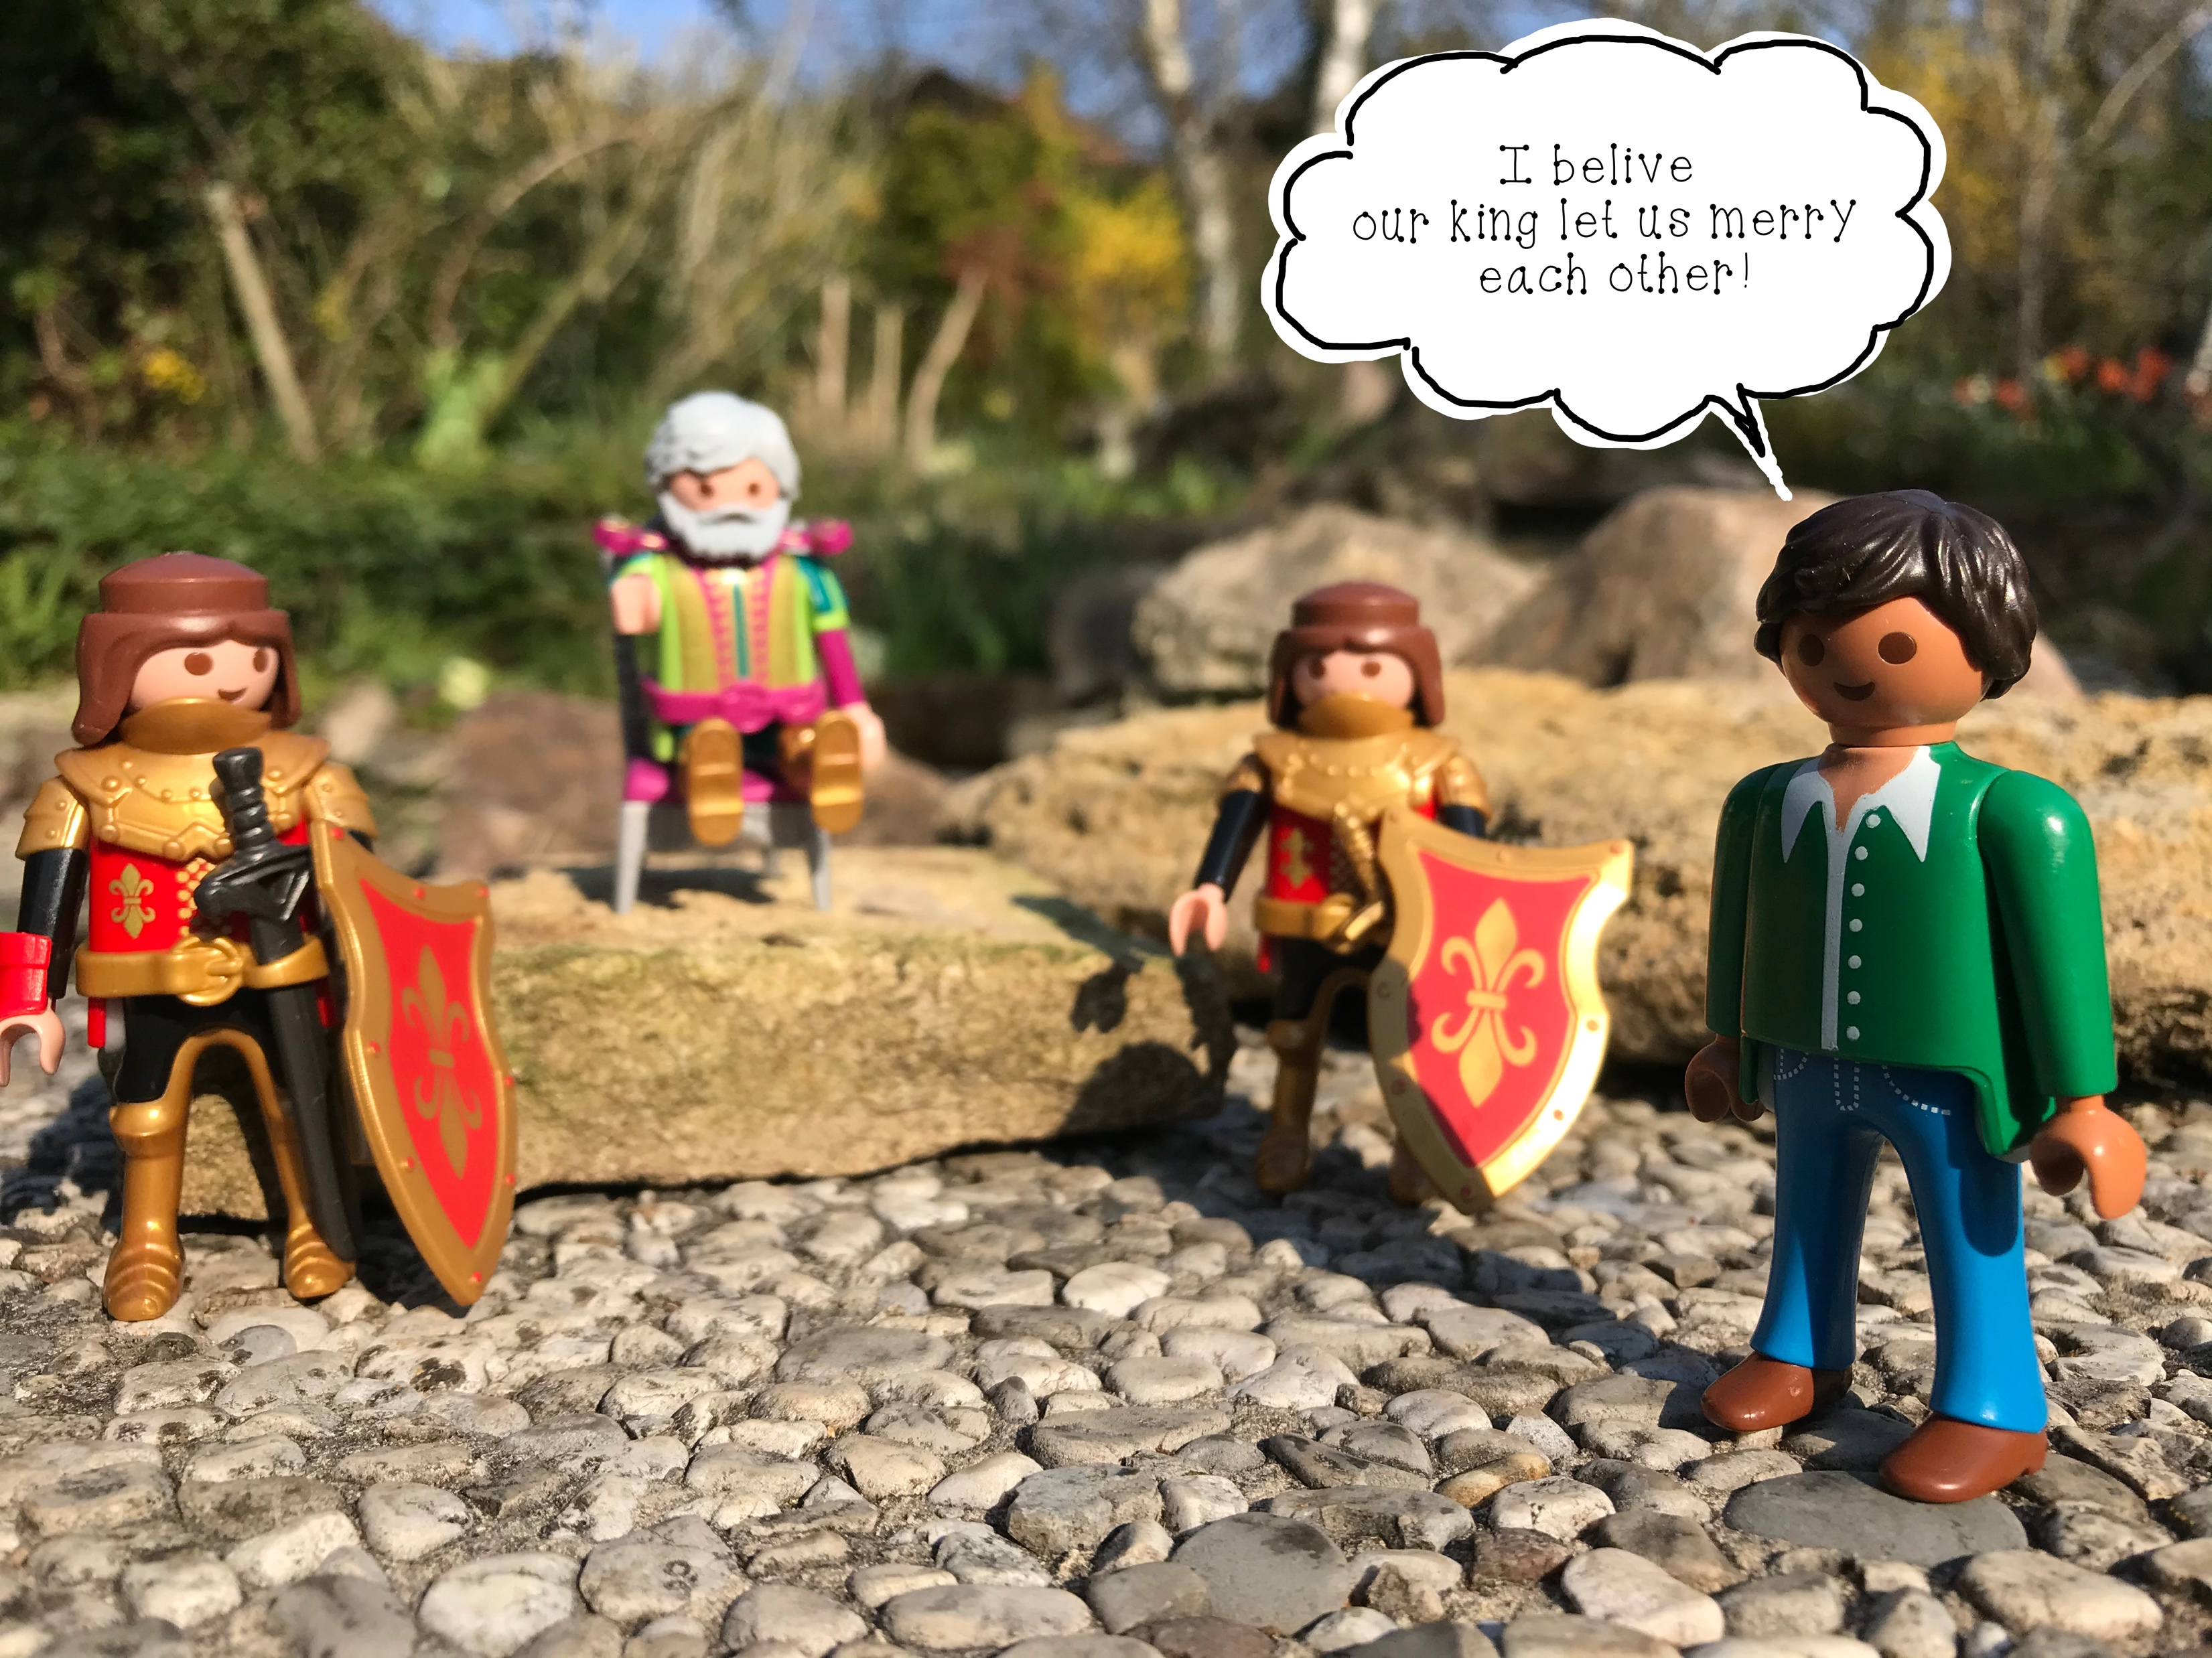

Slide 6
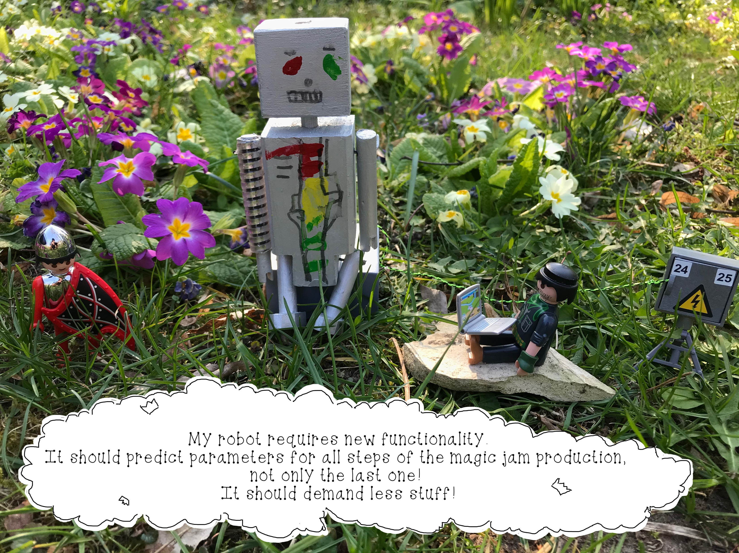
Notes:
Friendly intoduction to systems with compex datascience component ☺

Slide 7
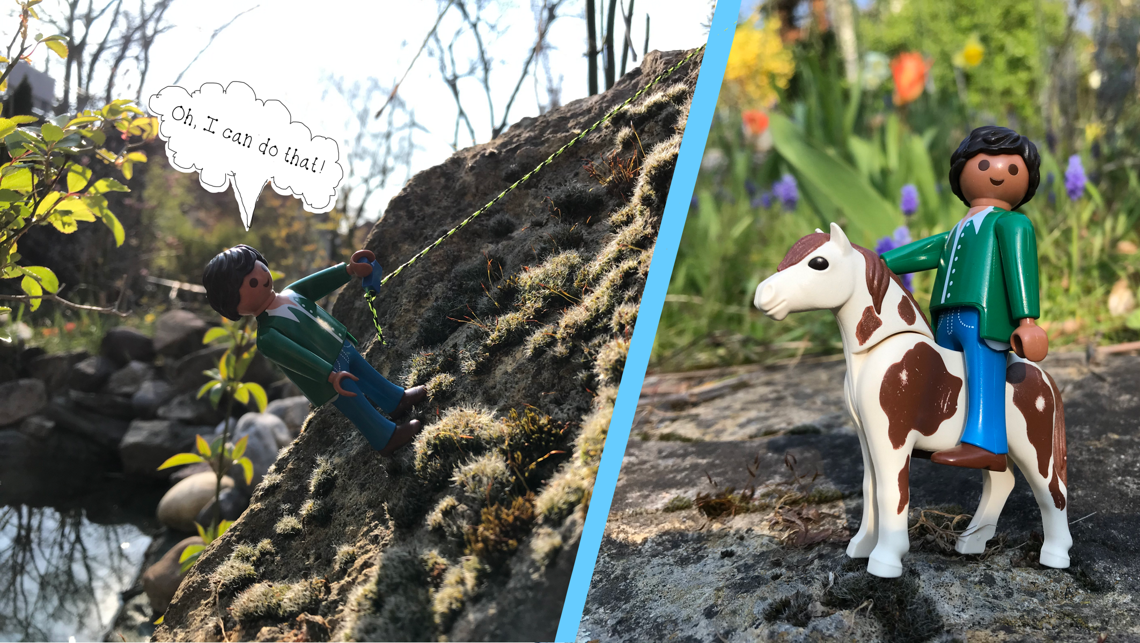

Slide 8
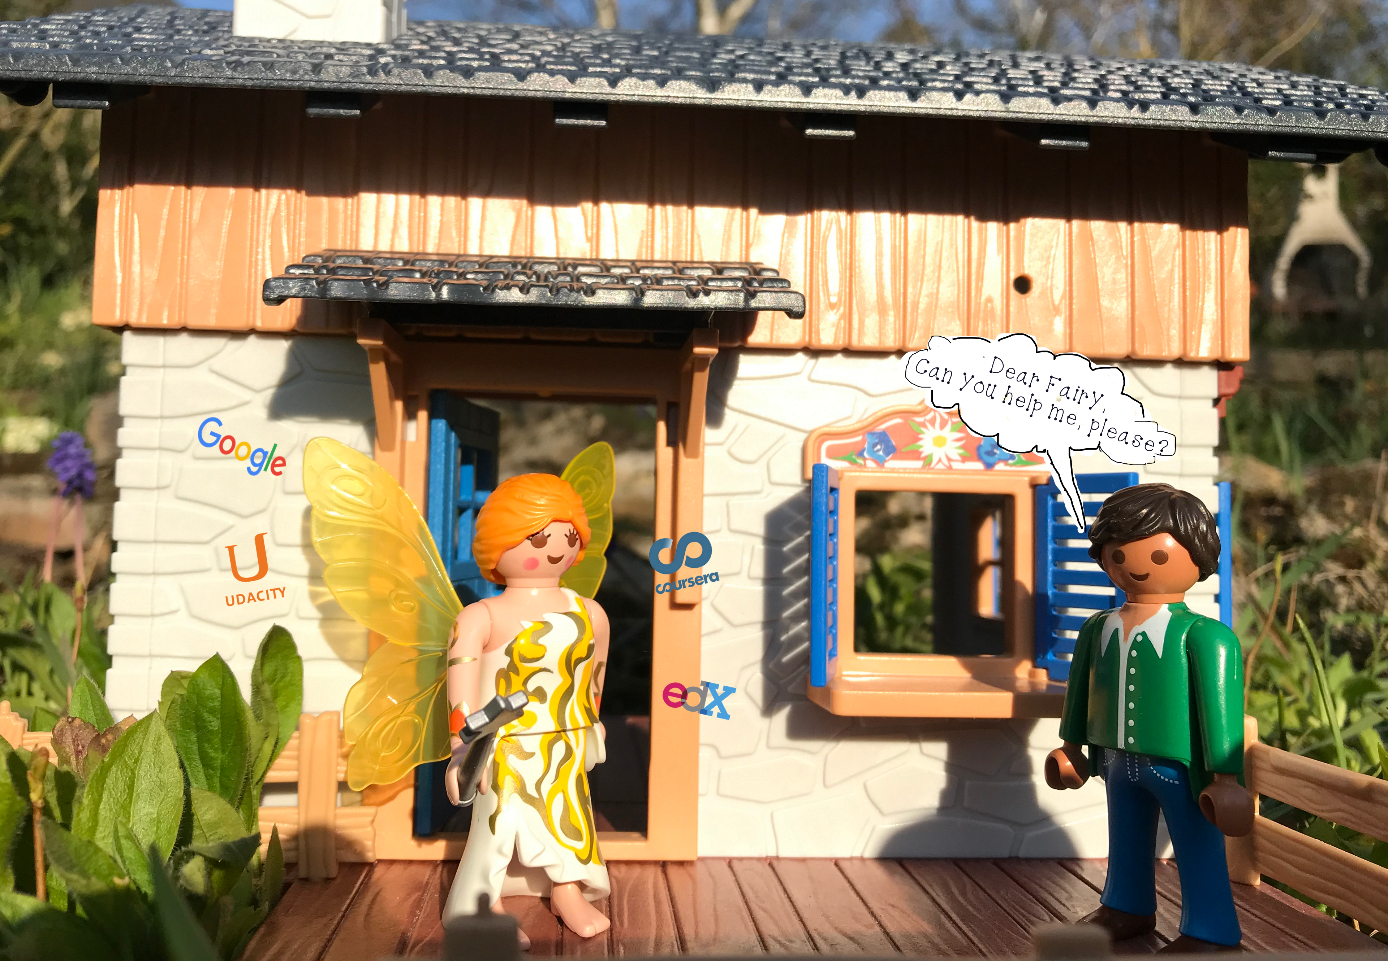

Slide 9
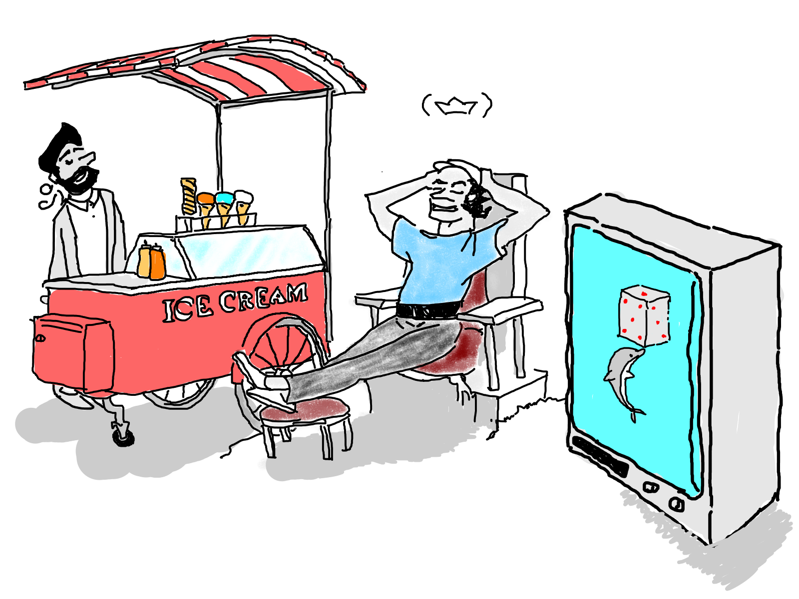
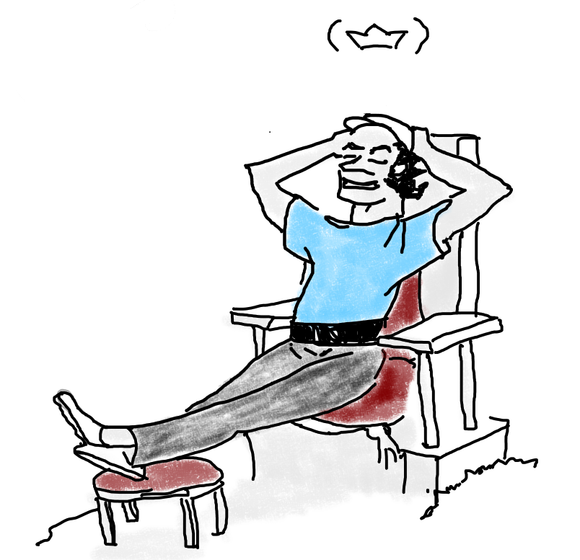
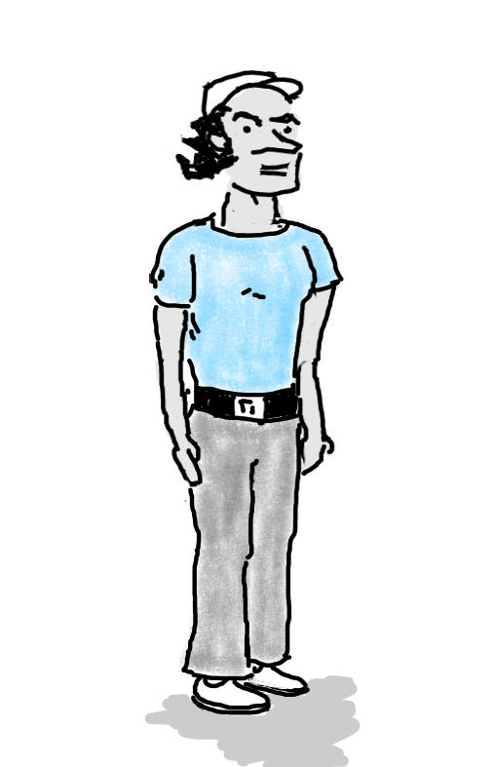
Client - King
Notes:
May be you are thinking – “Who is this guy in a nice stylish t-shirt and a cap?”
This is persona. Whom I mean? When we start a new project we have a design session. Here we define personas.
Let’s call him Johan. I don’t mean anyone, name is arbitrary. He is a data scientists. Very good data scientist. Probably married and so on.
Why I selected a data scientist's angle as a point to build this presentation?
Actually, in a system with complex data science component (explanation comes later) we will always have data scientist as a product user. If we could make his interaction with a system as simple as possible, it will bring us more opportunities, more hypothesis, more tries, more errors and as result more discoveries. Isn’t it exiting?!
So let’s create more comfort for data scientists. Hm, could be nice slogan.

Slide 10
Production Machine Learning
Scalability
Extensibility
Configuration
Consistency & repodusability
Modularity
Best practices
Testability
Monitoring
Safety & security
Notes:
To bild a comfort (easy usable, desirable, convinient, productive) system we have to reach, embody a bunch of principles, wich are listed on this slide.
I also like other definision which applies for all software architectures – good software architecture should be easy changeable. That’s quite important in agile development, right.

Slide 11
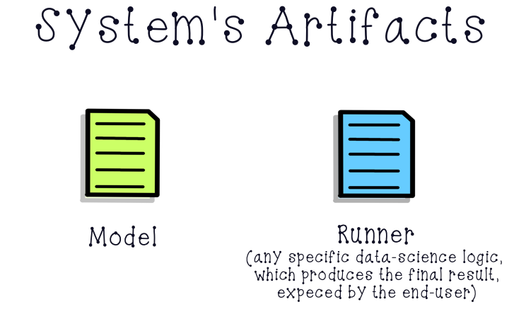
Notes:
Here I would like to introduce to pillars of the system with complex data science component:
The first one is model. Here under the model I mean not only discovered mathematical relation, but more like something alive (alive in quotes) like a service. This service can be deployed in cloud for example.
Personally I would preferer ocean metaphor before a cloud. So in this direction I would imagine a model as clever sea creature – dolphin, octopus, whale. And our task is building an interaction with them.
Second runner. Probably not very precise name. I got used to it in Smart. What do I mean under this name – this is the special logic (code) with data science plans to be executed with the model call.
It can be anything preprocess input parameters, post-process model output, way to run inference, like genetic algorithm. In backend we often use the other name – function.
However, disregarding nationwide love to mathematics I would prefer to stick to “runner”.
Now we no the basics let’s go to a problem definition.

Slide 12
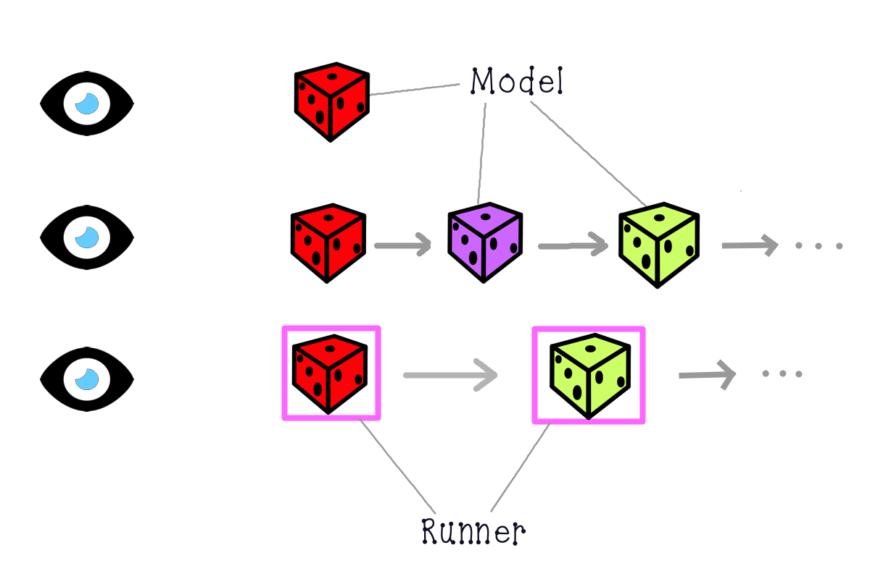
Problem statement
(simple case)
Notes:
Problem definition.
On the left side we have pictures of eyes and on the right side dices and squares.
Dices represent models. Squares - runners.
This pictures describe situations when we can predict exacly how our system will ivolve in time. We know here wich models we will use and in which sequence.
Highly likely we will never update this modes or sequences of model. We can harcode a lot here.
For example, popular at the beggining of this year FaceApp – AI face editor.
We won’t track this kind of issues here however development logic can be inherited here.

Slide 13
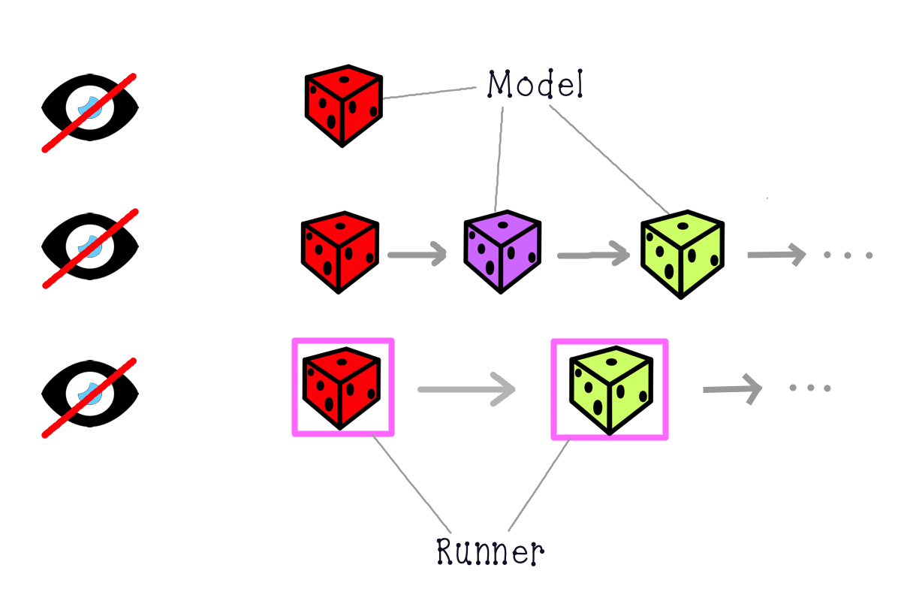
Problem statement
(complex case)
Notes:
The problem we will be working with is unpredictability, which will always accompany our platform.
Here we do not know anything about models our user will use in future, as well as how they will be chaned together.
Disclaimer, under chaining, I mean separate models, not layers and branches within a one model.
Unpredictability bring a lot of intergational pain. A team can end up with handling a lot of if else cases.Covering of all possible combinations takes a lot of effort and time.
If I could illustrate emotional power involved, I would illustrate it with the next imaginary situation.
Let’s imagine the ordinary and arbitrary BIX employee. She leaves in Mainz, and today she has a presentation for, let’s say BIX leadership team.
Yeh, probably, conditions are not so impressive, so let’s add also Mr. Hubertus von Baumbah, who also wants to see that presentation.
So, everithing is planned. I have leave the home at …, At … I have to take a bus, the train to Ingekheim at …
She leaves her home at time, but then something goes unexpectedly. As a result when she arrives on the railway station, she sees the last train car moving away.
This train is the last which arrives before the meeting starts.
She doesn’t get confused, not time for grieving. She starts her run, to сatch up the train, and somewhere in, let’s say, Heidesheim, she overtakes it, and arrives at the Hive as expected.
But even with this example I have no reach full emotional involvement, so let’s bring some agility in our example.
Imagine she ariving to the office, and find out that meeting was rescheduled for tommorow.

Slide 14
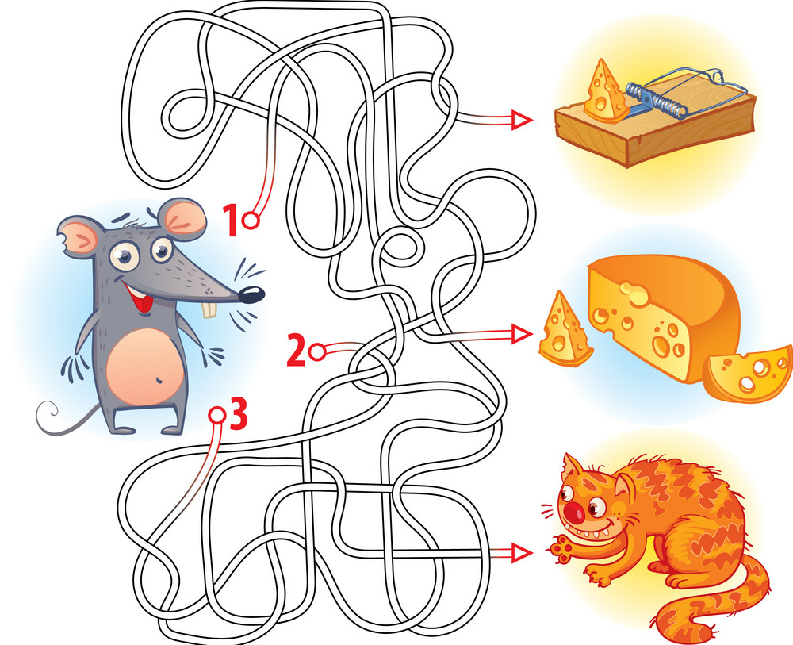

Automated chaining of multiple models (back-end developer’s or data scientist’s view)
pictures from https://press.princeton.edu/books/hardcover/9780691154046/dante and https://www.vectorstock.com/royalty-free-vector/help-the-mouse-to-find-the-right-way-in-the-maze-vector-18445765
Notes:
Here are two images one funny one for illustration of 3 different options to investigate, the other – Dante Aligiery with his Inferino lines.
On psychological level you can fill that when complexity increases, I it hard to motivate outselves to go farther to investigate more, to take more risk.

Slide 15
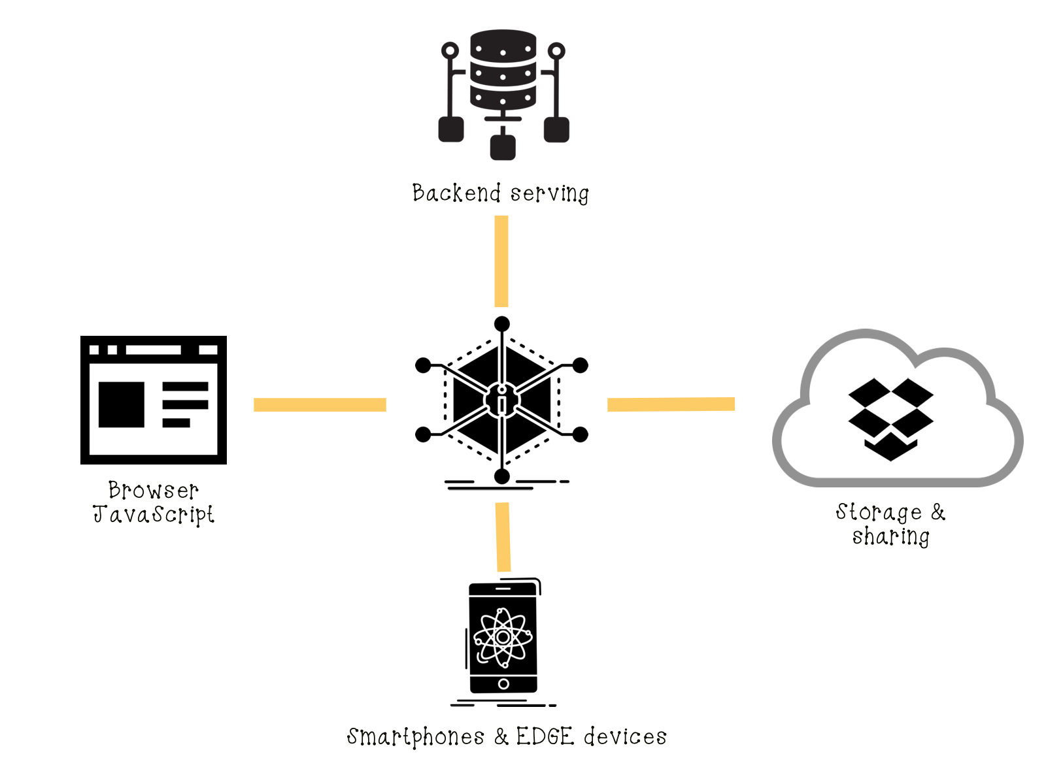
Complecities / Possibilities
Icons taken from https://www.iconfinder.com/

Slide 16
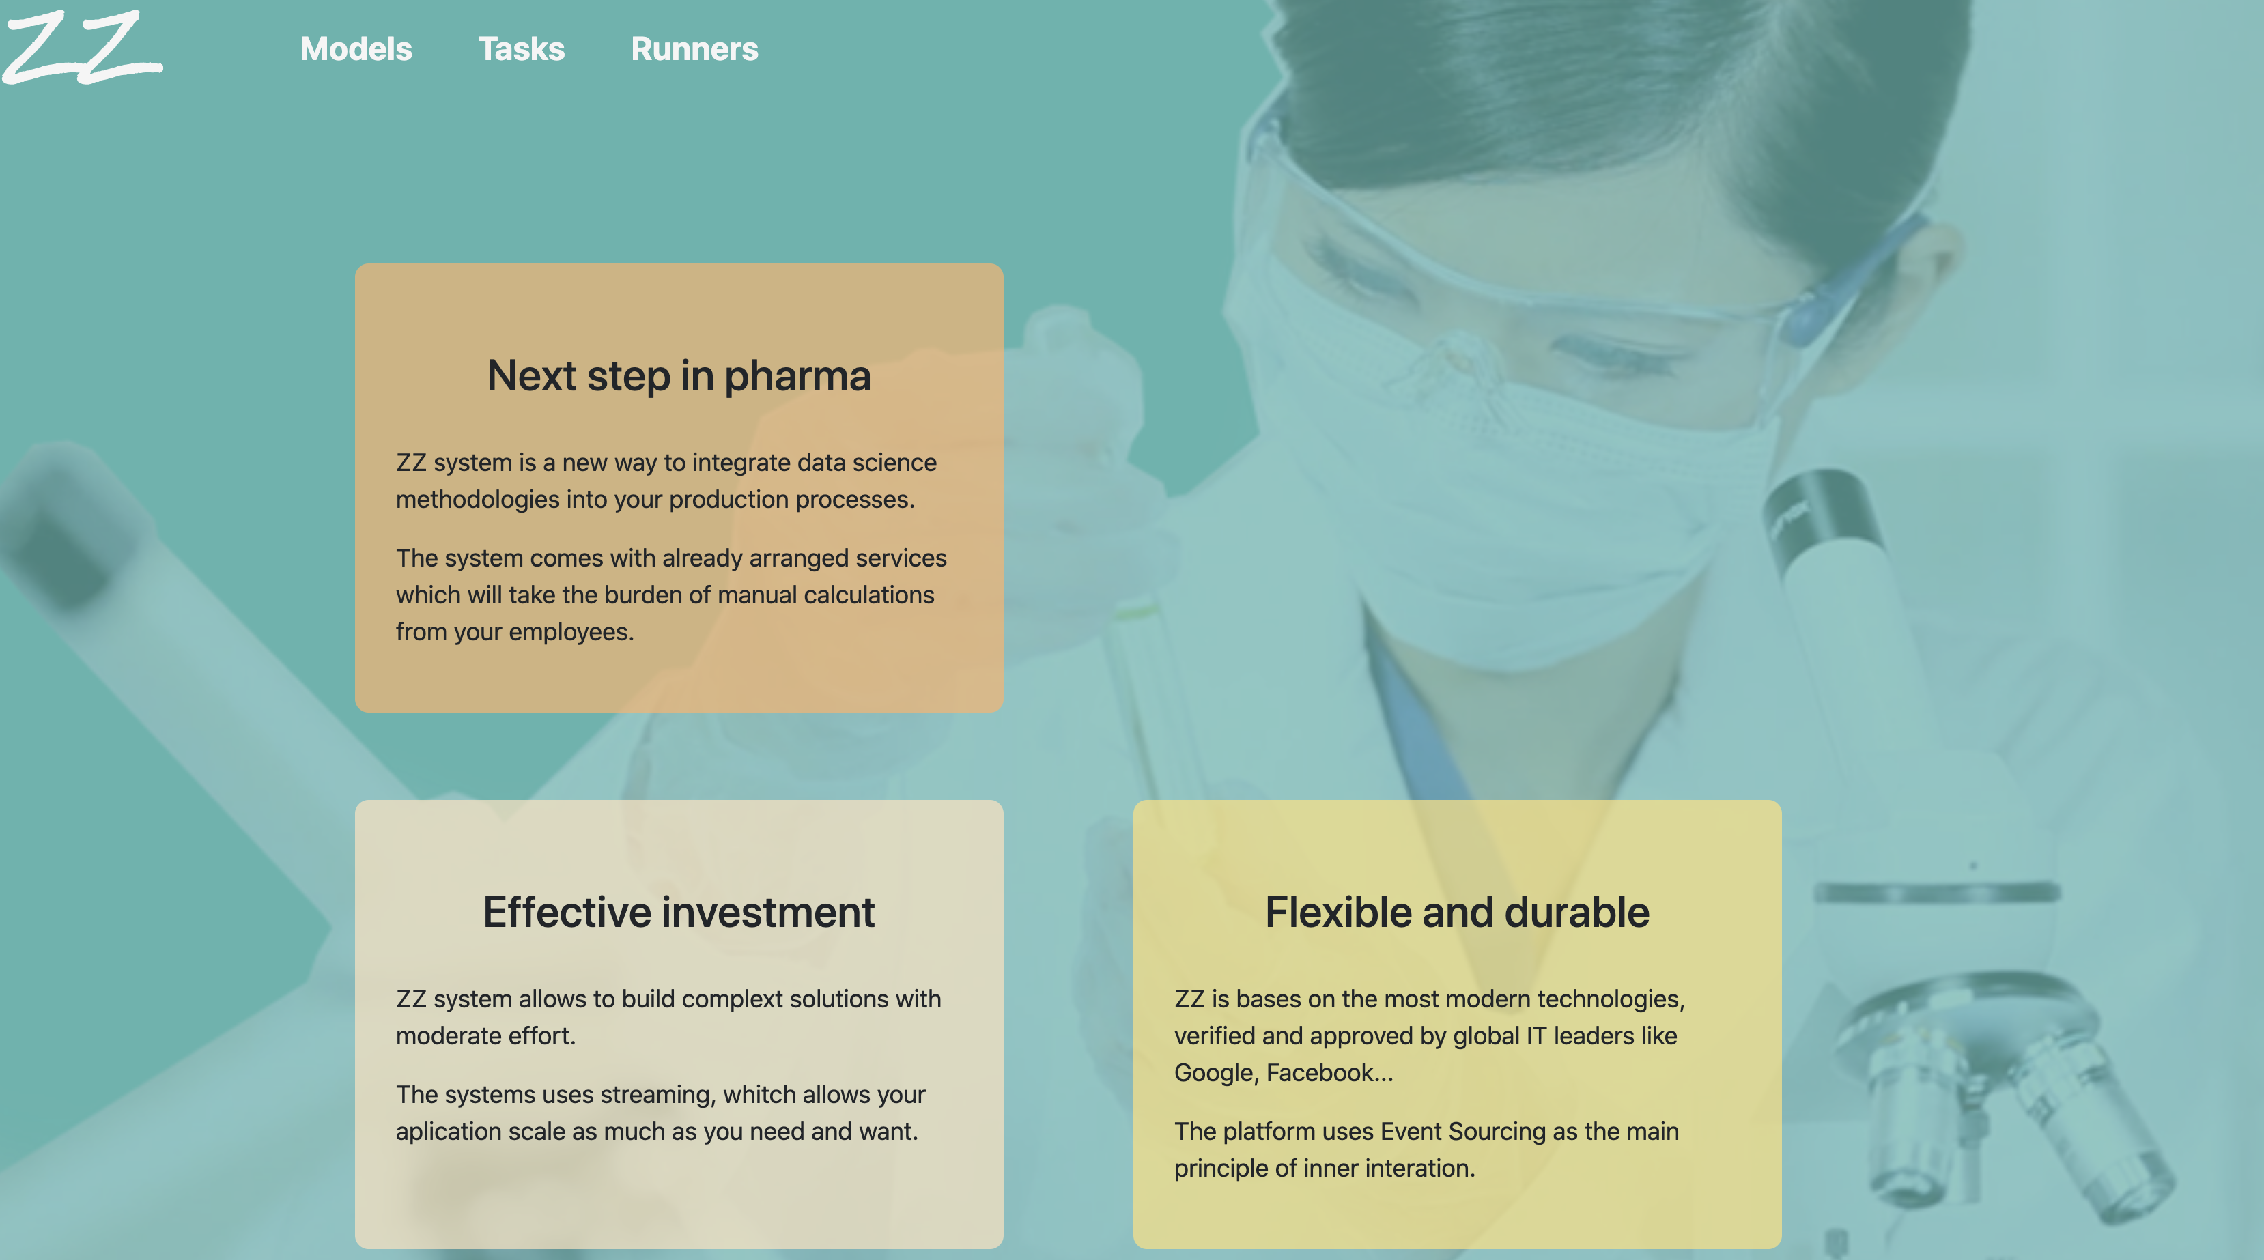
Application
Notes:
Application can be found here: https://facade-zz-test.22ad.bi-x.openshiftapps.com/
THE APPLICATION IS MODELAGNOSTIC !!!

Slide 17
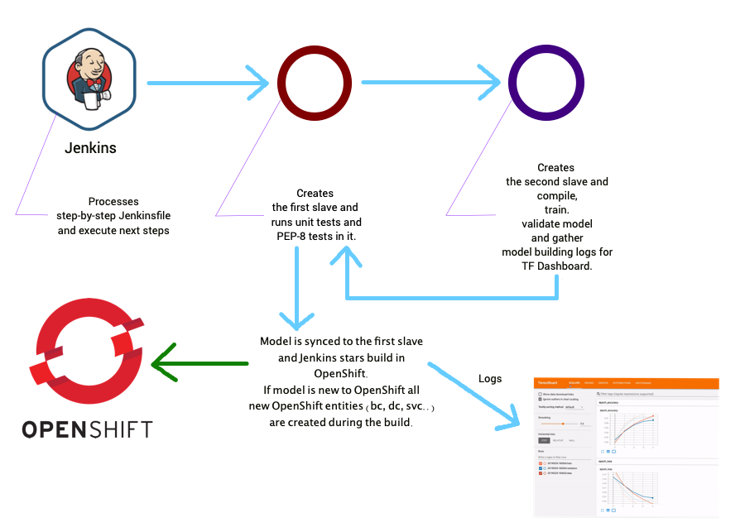
How models are built
More on build:
More Tensorboard
Notes:
More on build: https://bitbucket.bix-digital.com/projects/ZZ/repos/zz-ds-artifacts/browse/Jenkinsfile
Tensorboard: https://tensorboard-zz-cd.22ad.bi-x.openshiftapps.com
My models:
1. Dummy: https://bitbucket.bix-digital.com/projects/ZZ/repos/zz-ds-artifacts/browse/models/mod-dummy/build/scripts/train_model.py
2. Text classifier: https://bitbucket.bix-digital.com/projects/ZZ/repos/zz-ds-artifacts/browse/models/mod-text-class/build/scripts/train_model.py

Slide 18
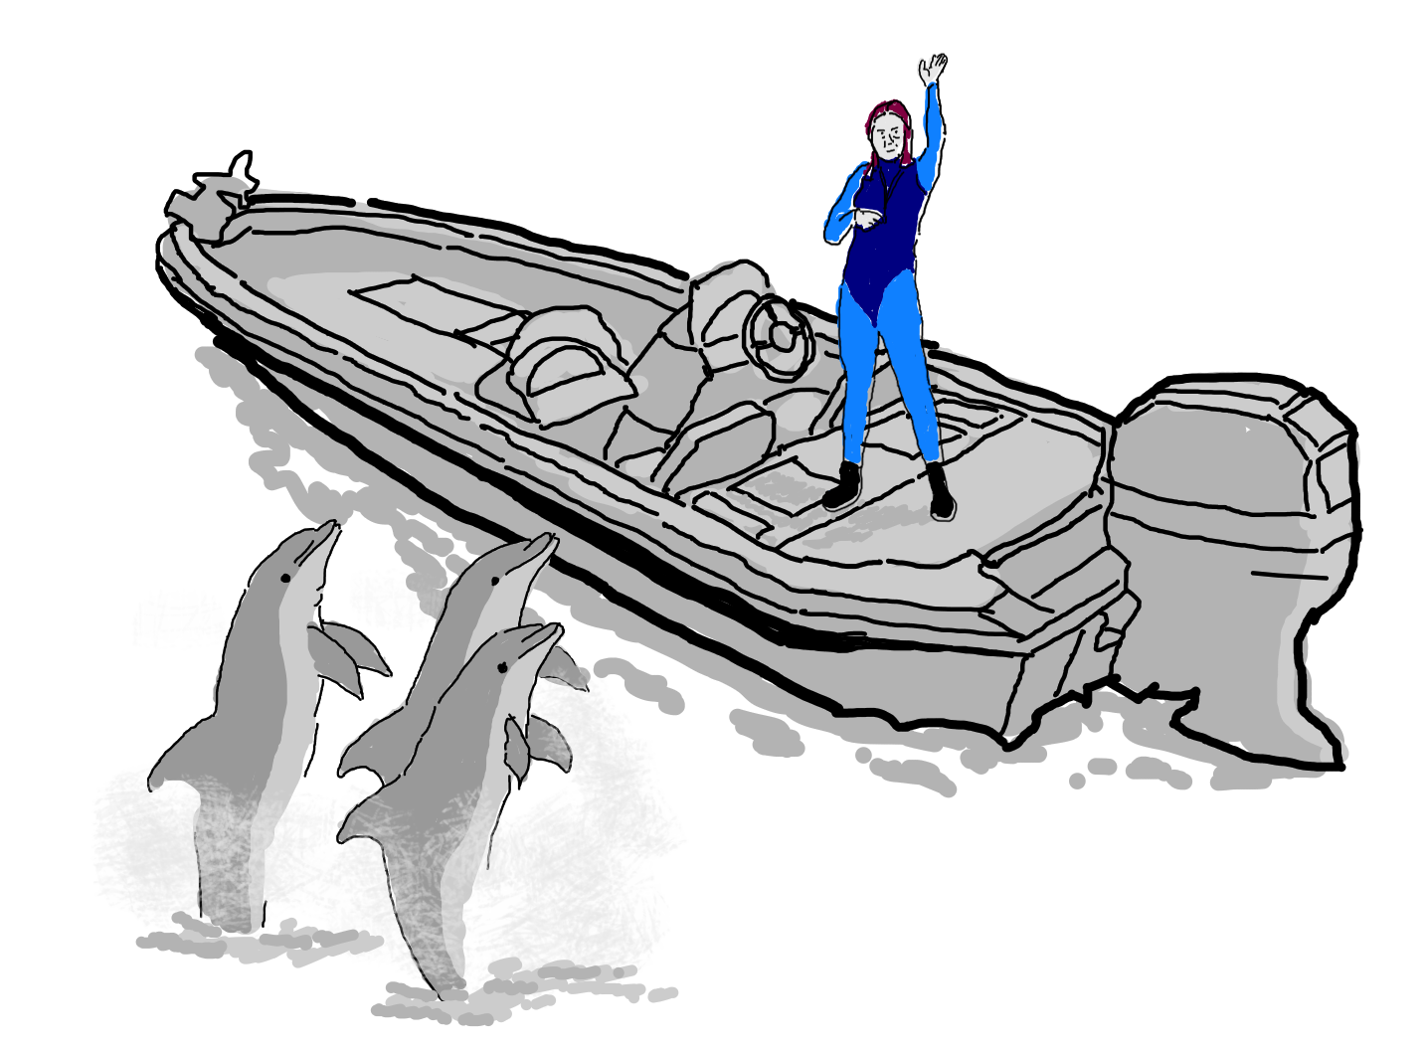
Models & Compute Service

Slide 19
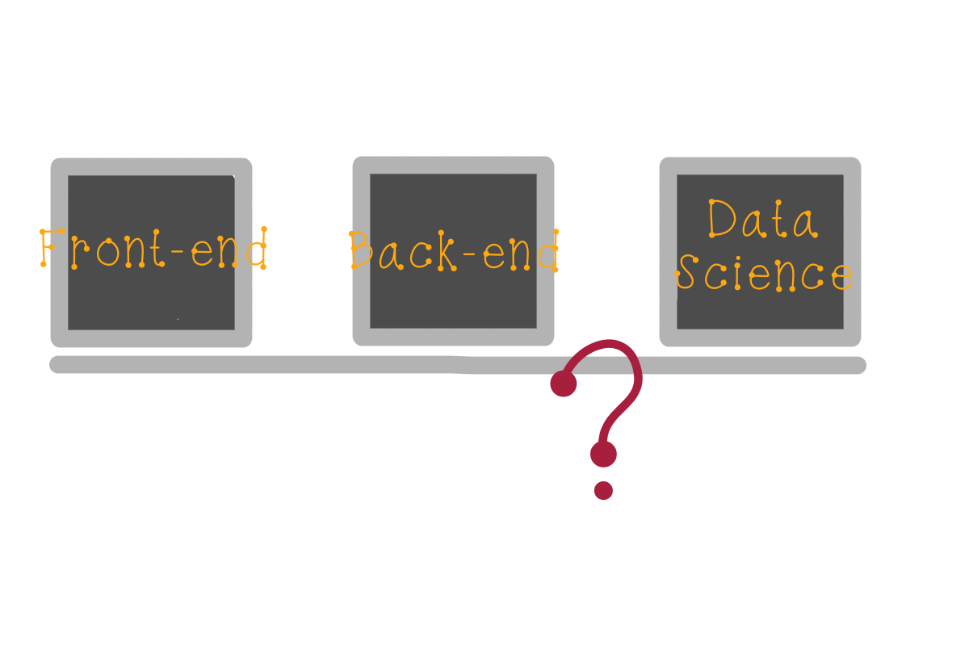
Joining together

Slide 20
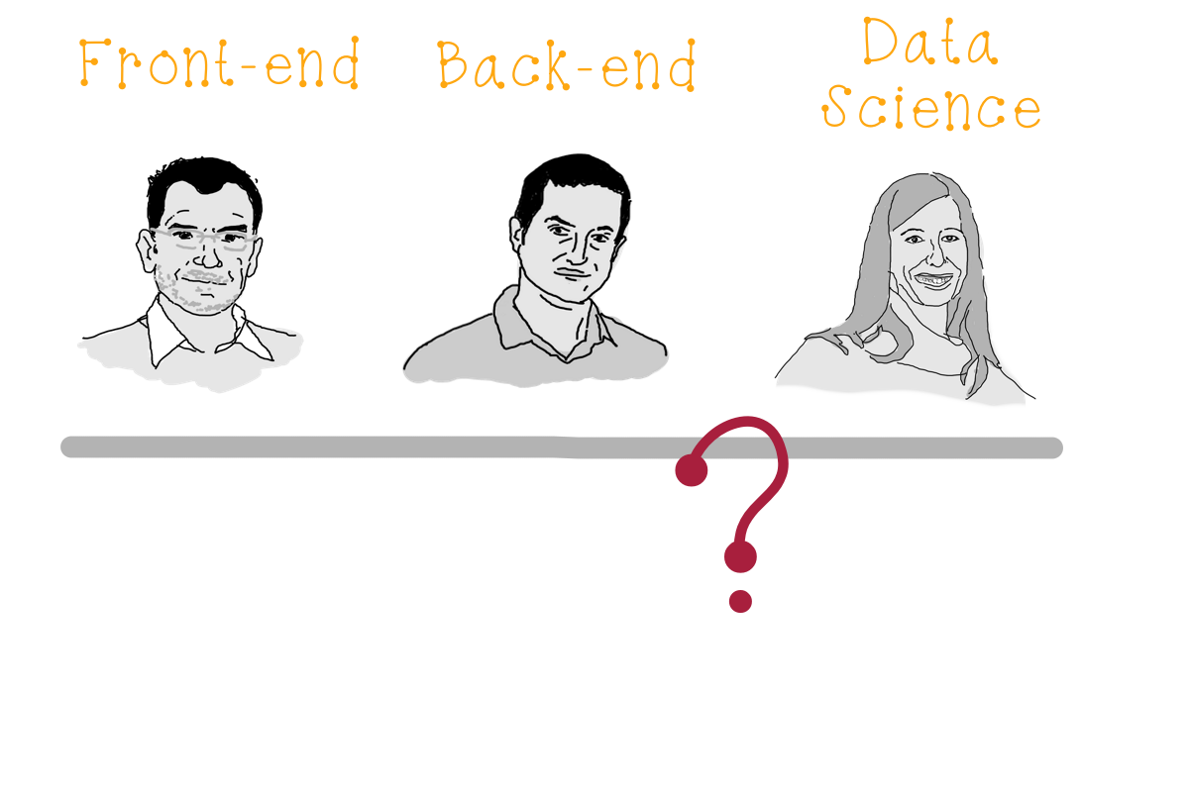
Joining together
(UI friendly)
Notes:
How to avoid multiple cycles of integration the same model? Make integration seamles?

Slide 21
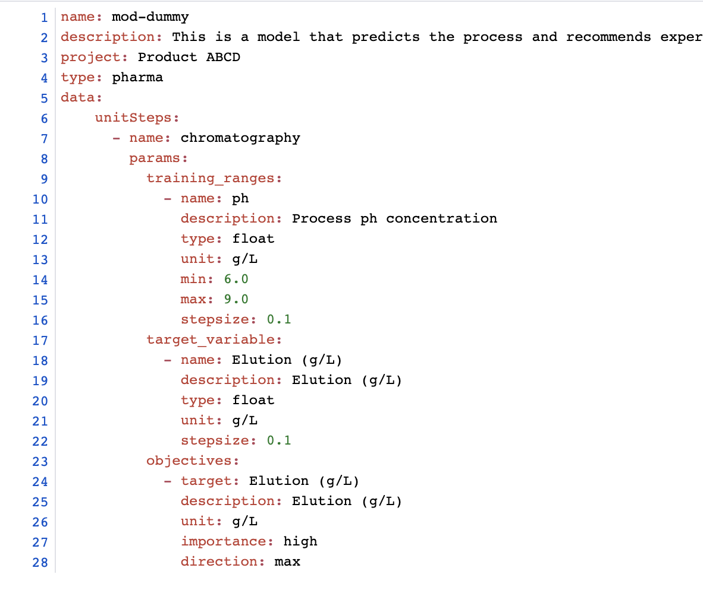
Model business metadata

Slide 22
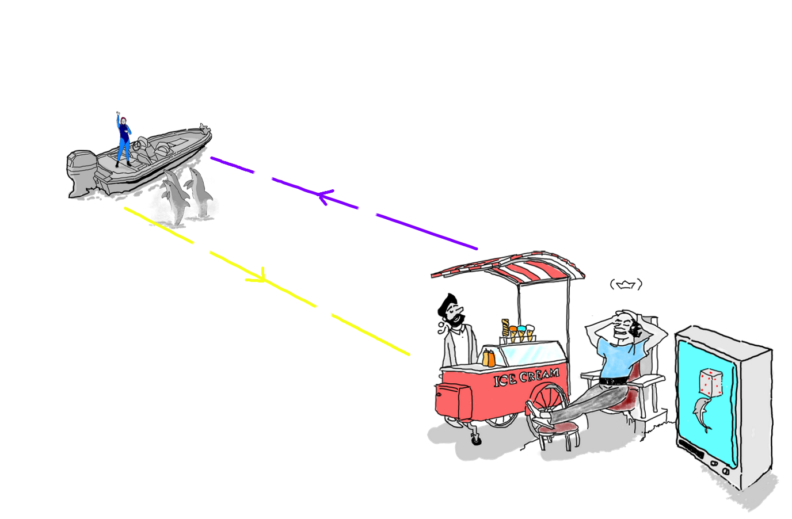
System interaction

Slide 23
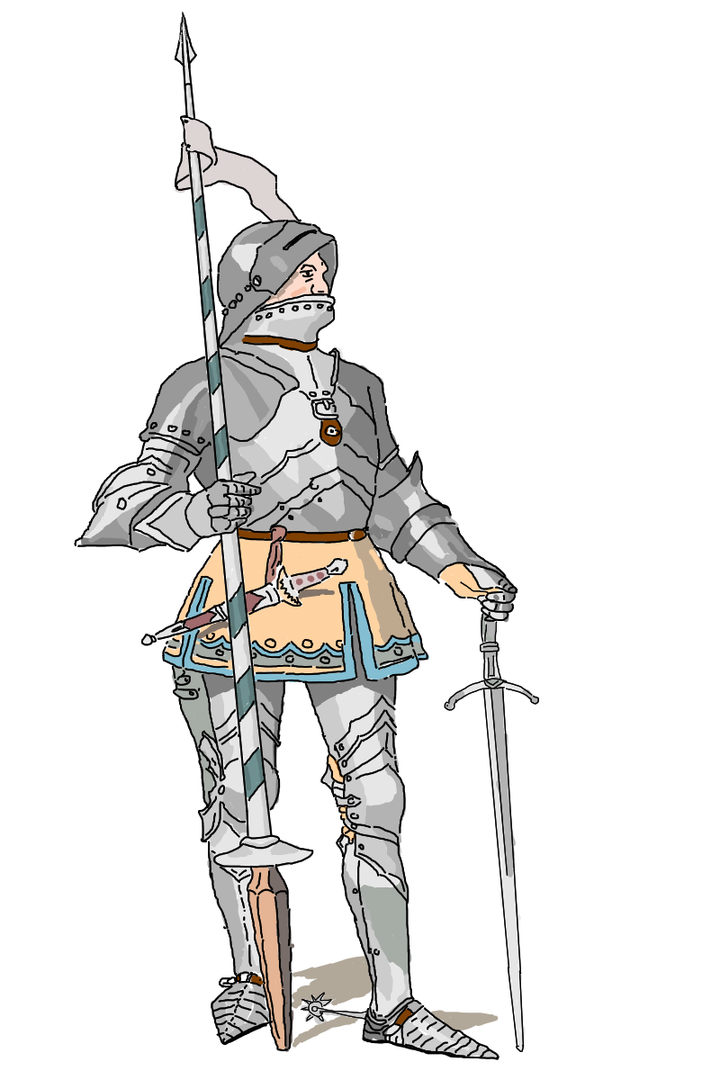
Function Security
Notes:
Within this topic

Slide 24
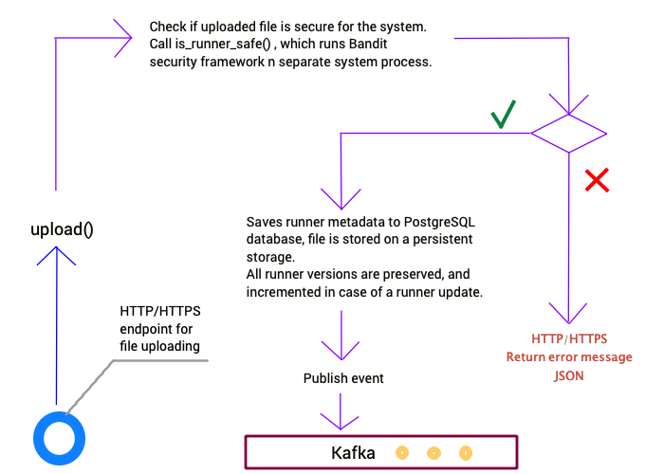
How FaaS works

Slide 25
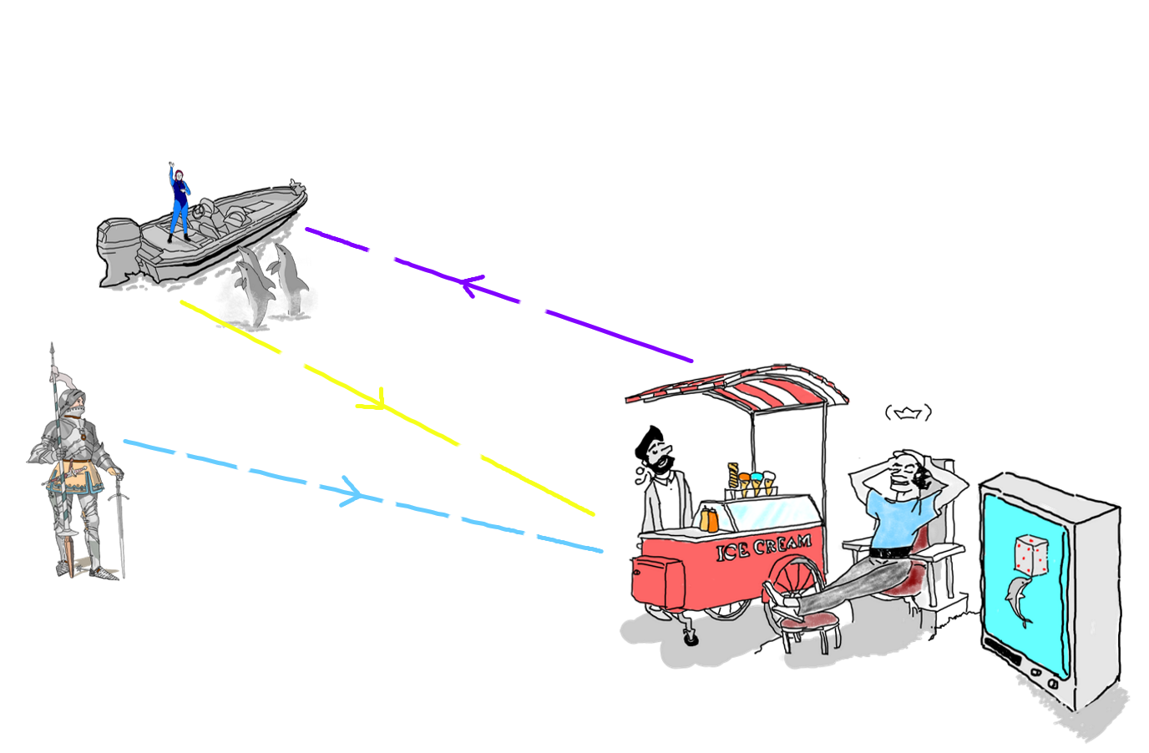
System interaction

Slide 26
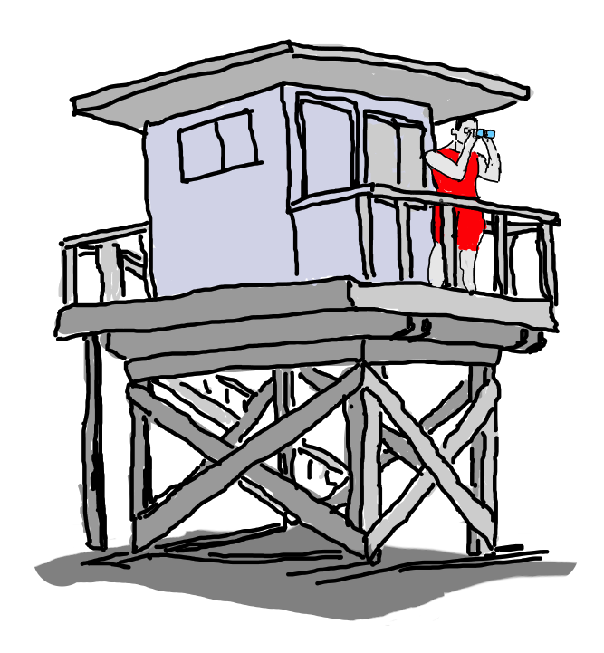
Model Monitoring Service

Slide 27
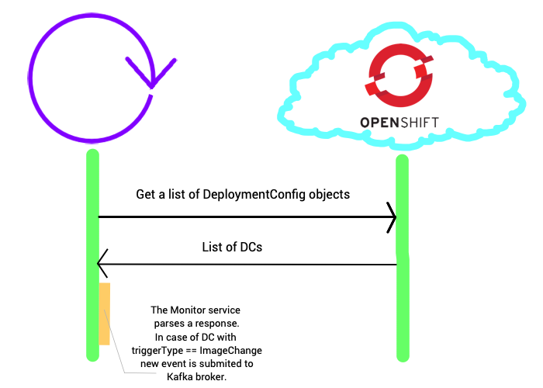
How model monitoring service works

Slide 28
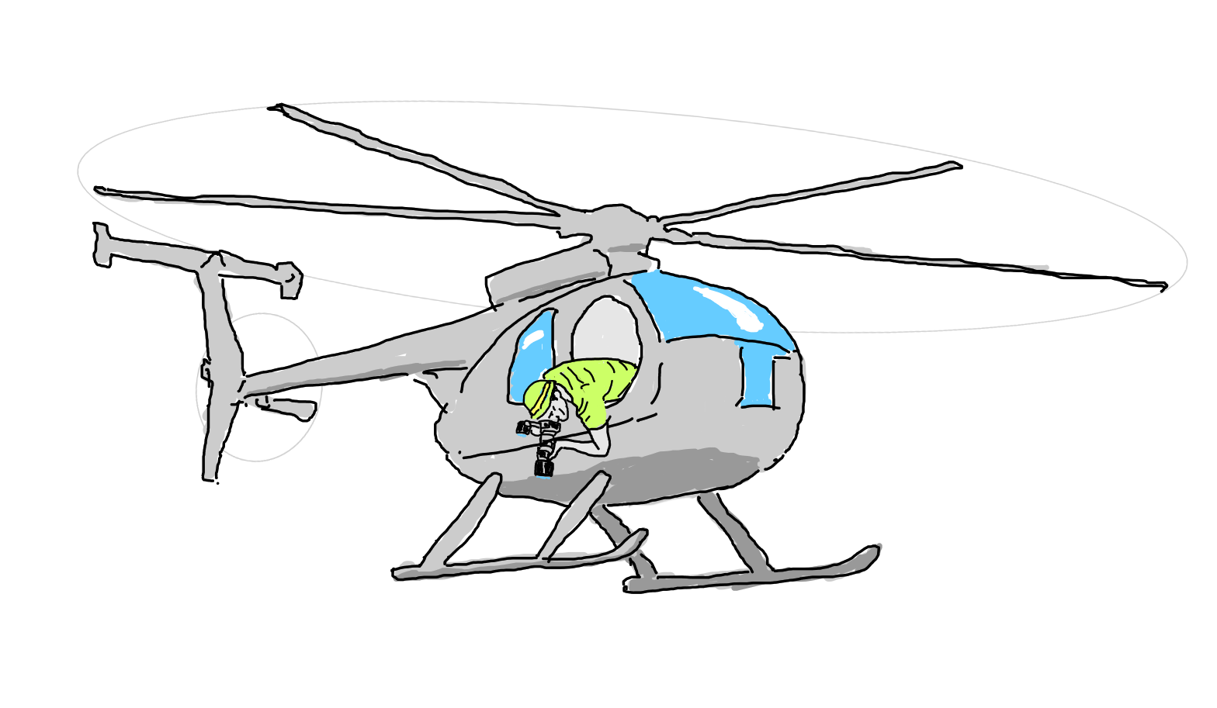
Model Scanner Service

Slide 29
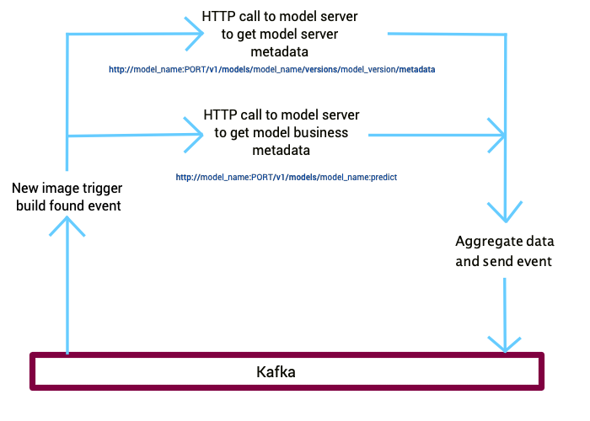
How scanner service works

Slide 30
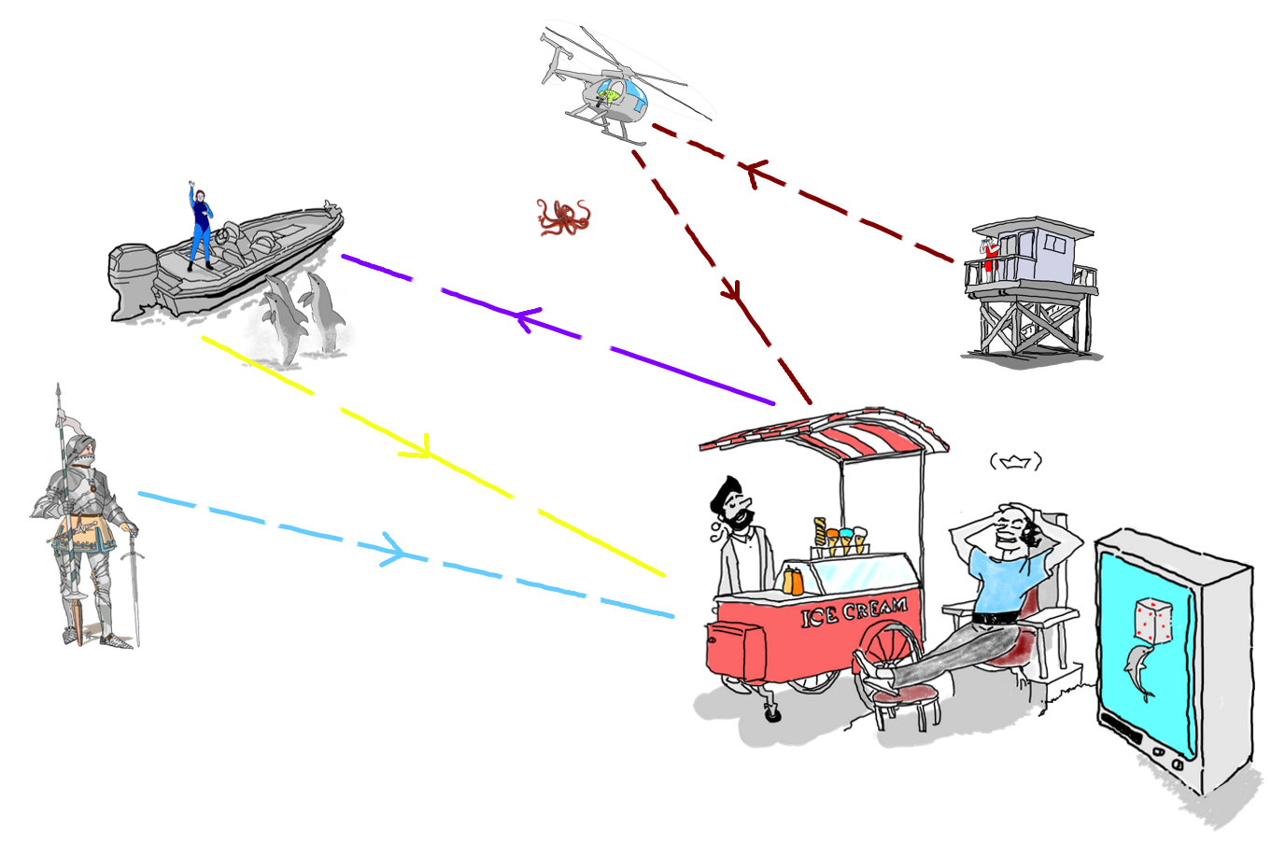
System interaction

Slide 31
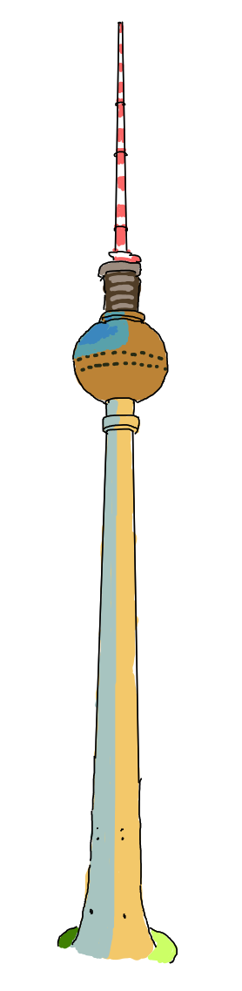
Service choreography
Notes:
Betchoven vs Chaikovsky.

Slide 32
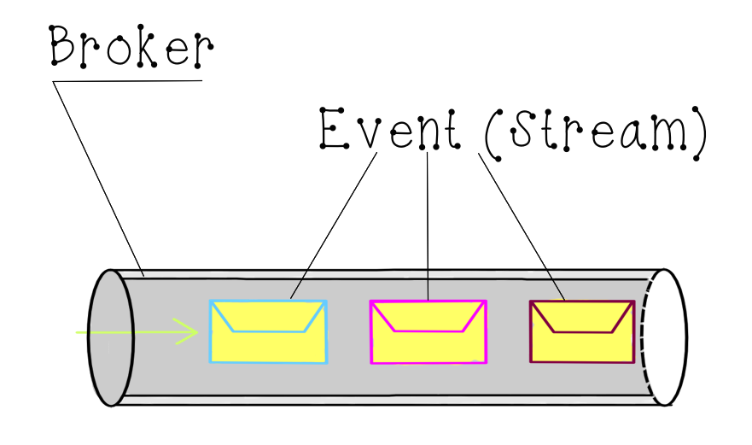
What is Kafka

Slide 33
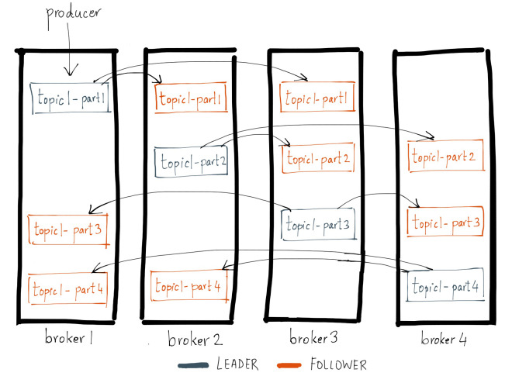
What is Kafka
(more complex picture)
Taken from: https://www.confluent.io/blog/stories-front-lessons-learned-supporting-apache-kafka/

Slide 34

Kafka in OpenShift
More: https://strimzi.io/ and
https://kubernetes.io/docs/concepts/extend-kubernetes/operator/
Monitoring UI

Slide 35
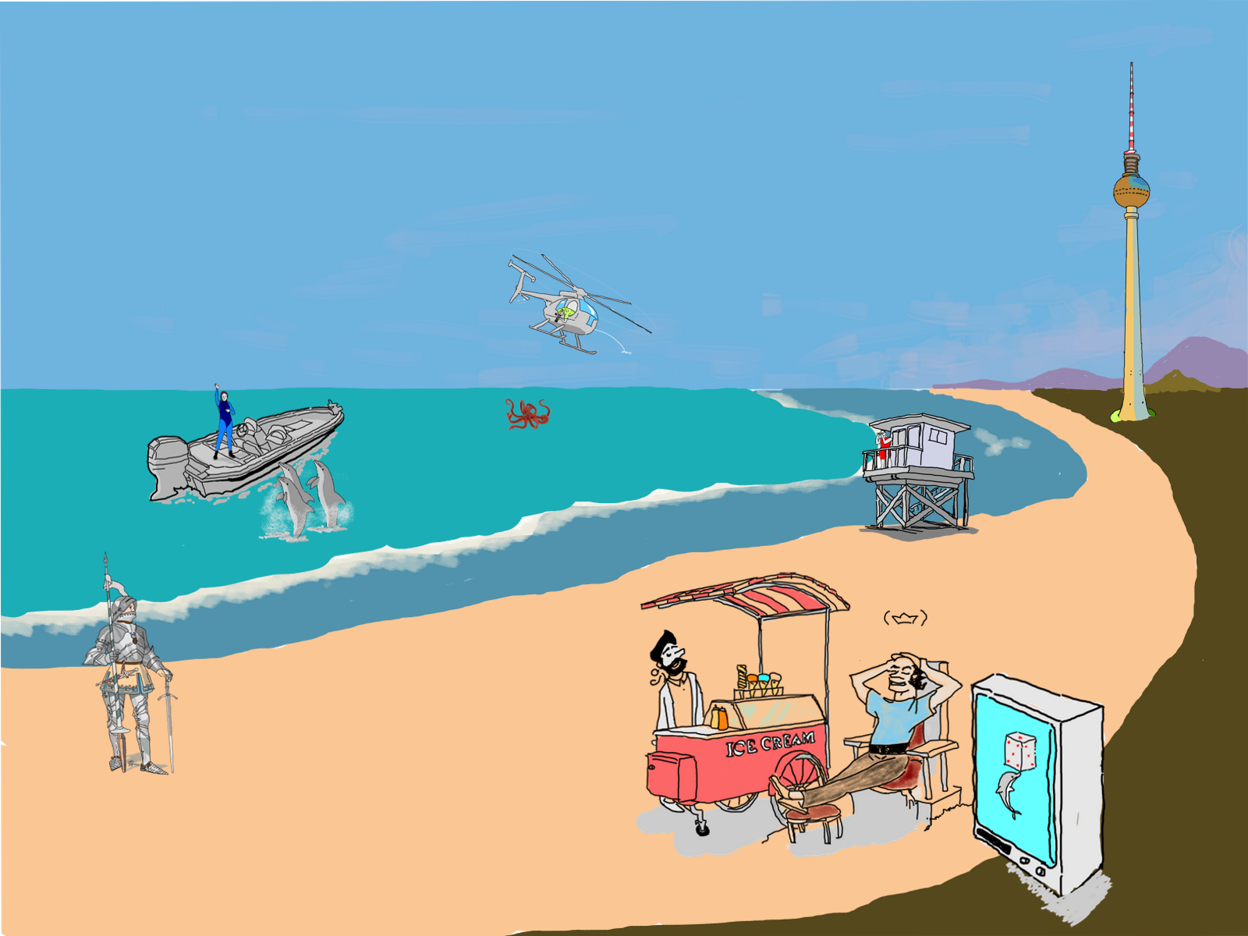
The whole system

Slide 36
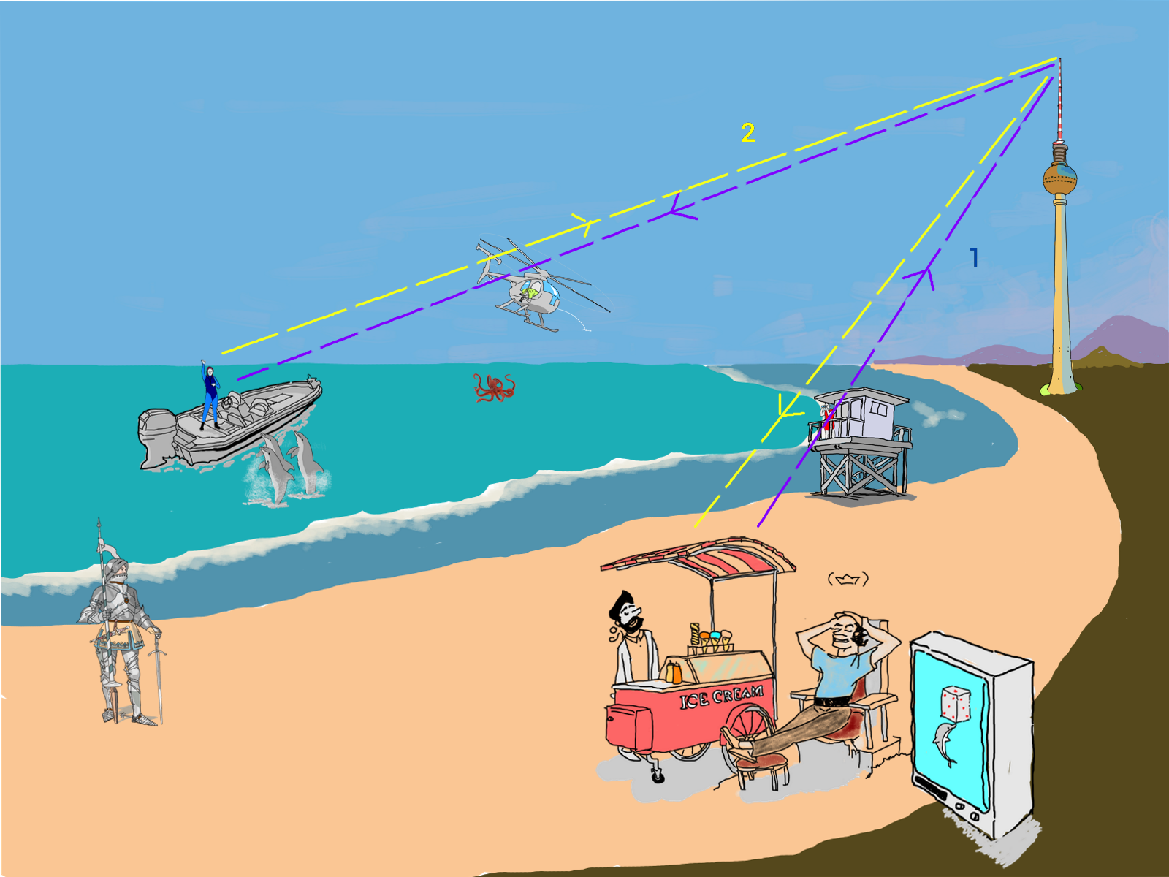
Inference process

Slide 37

New model discovery process

Slide 38
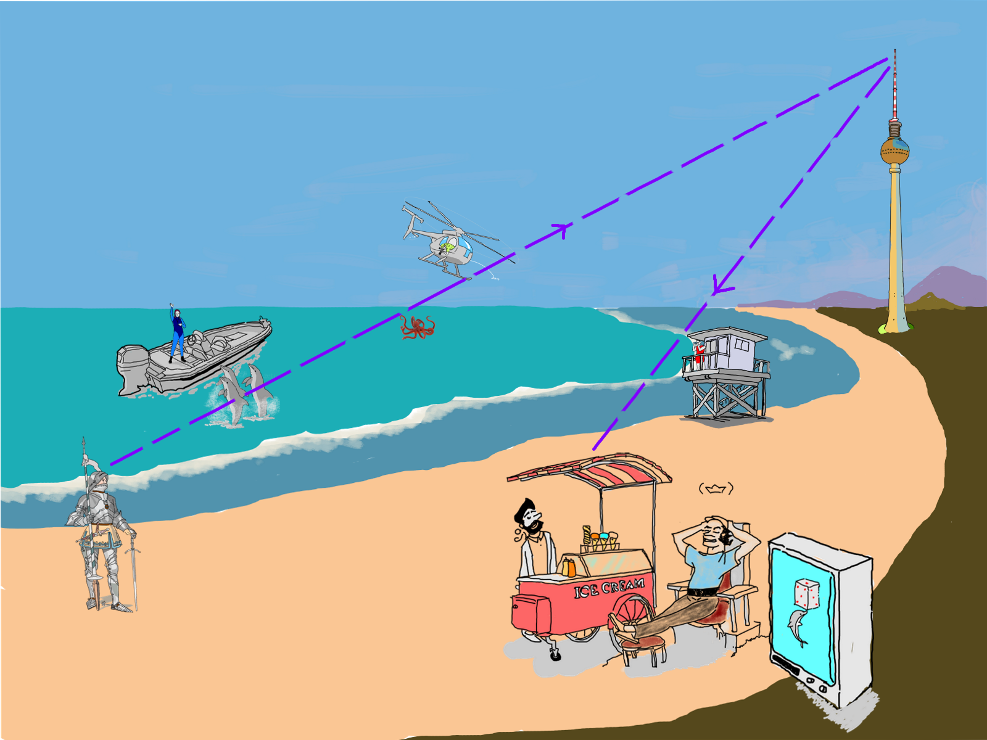
New runner upload
process interation chain

Slide 39
Bonus

Slide 40
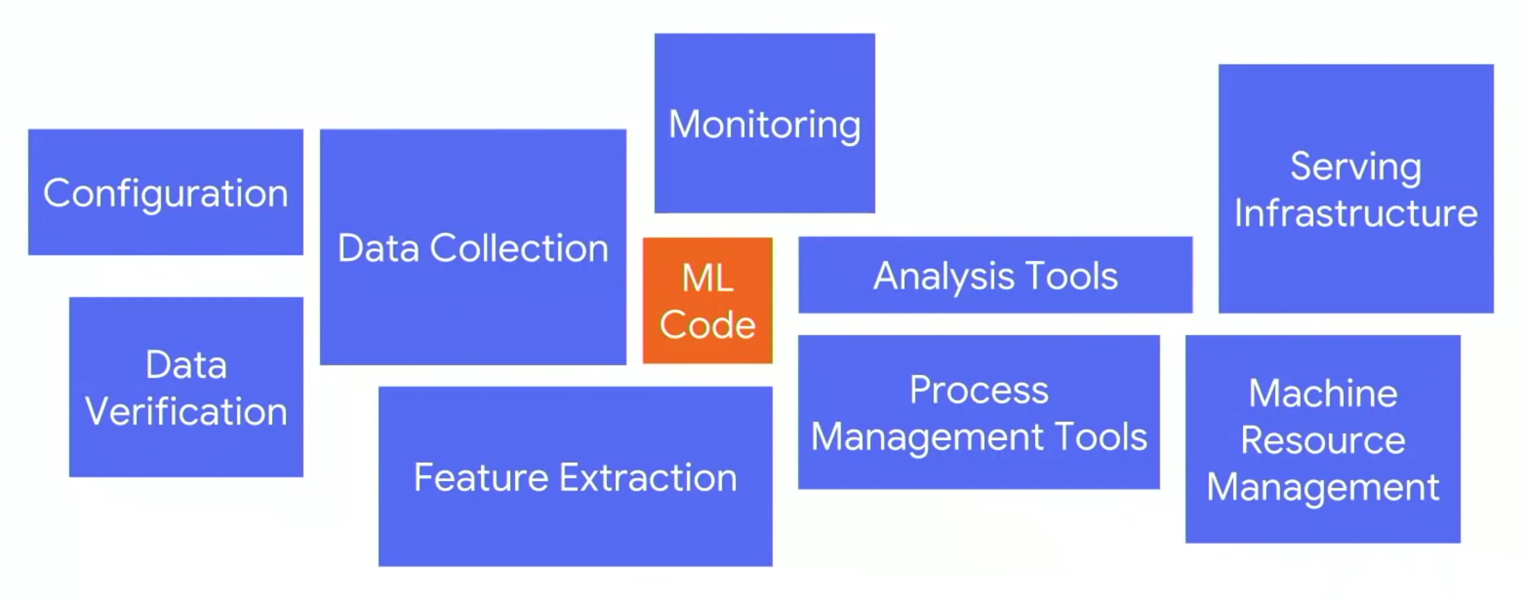
ML production process
Taken from https://learning.oreilly.com/library/view/tensorflow-machine-learning/9781789132212/7aaa9efc-f53d-403a-9c7a-39f2d23d9471.xhtml

Slide 41
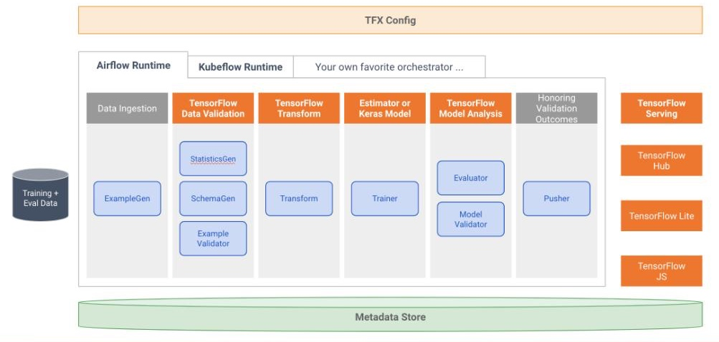
TFX putting all together
Taken from https://medium.com/tensorflow/introducing-tensorflow-data-validation-data-understanding-validation-and-monitoring-at-scale-d38e3952c2f0

Slide 42
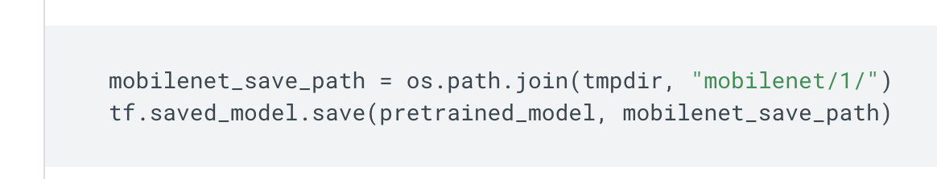
SavedModel Complexities ☺
Follow: https://www.tensorflow.org/guide/saved_model?hl=fr

Slide 43
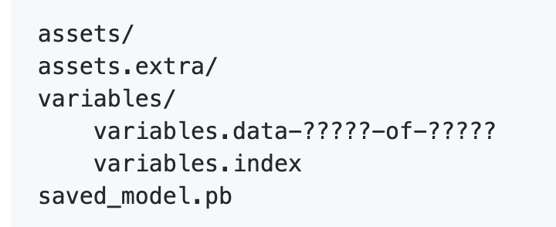
Saved model folder’s structure
Follow: https://github.com/tensorflow/tensorflow/blob/master/tensorflow/python/saved_model/README.md
Notes:
SavedModel protocol buffer
saved_model.pb or saved_model.pbtxt
Includes the graph definitions as MetaGraphDef protocol buffers.
Assets
Subfolder called assets.
Contains auxiliary files such as vocabularies, etc.
Extra assets
Subfolder where higher-level libraries and users can add their own assets that co-exist with the model, but are not loaded by the graph.
This subfolder is not managed by the SavedModel libraries.
Variables
Subfolder called variables.
Includes output from the TensorFlow Saver.
variables.data-?????-of-?????
variables.index
The variables directory contains a standard training checkpoint
The assets directory contains files used by the TensorFlow graph, for example text files used to initialize vocabulary tables. It is unused in this example.
SavedModels may have an assets.extra directory for any files not used by the TensorFlow graph, for example information for consumers about what to do with the SavedModel. TensorFlow itself does not use this directory.

Slide 44

Working examples
Notes:
I’ve made a lot of investifation how to integrare business data with savedmodel.

Slide 45
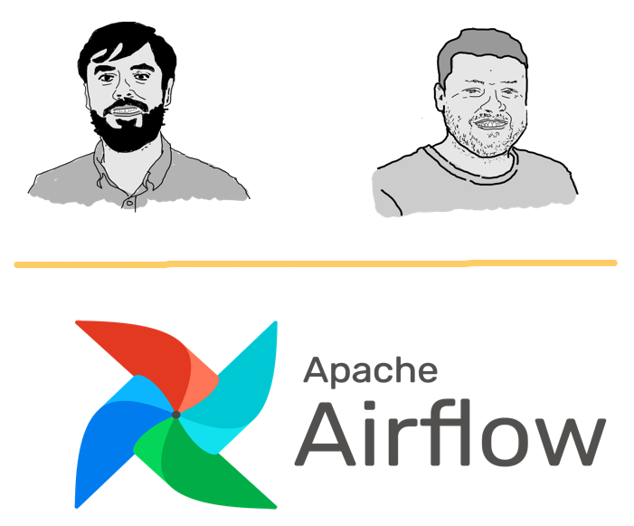
Our Airflow heroes

Slide 46
Q&A

Slide 47
